Slide 1
Arithmetic
Co Processor (8087)

Slide 2
INTRODUCTION
8087 was the first math coprocessor for 16-bit processors designed by Intel.
It was built to pair with 8086 and 8088.
The purpose of 8087 was to speed up the computations involving floating point calculations.
Addition, subtraction, multiplication and division of simple numbers is not the coprocessor’s job.
It does all the calculations involving floating point numbers like scientific calculations and algebraic functions.

Slide 3
INTRODUCTION
By having a coprocessor, which performs all the calculations, it can free up a lot of CPU’s time.
This would allow the CPU to focus all of its resources on the other functions it has to perform.
This increases the overall speed and performance of the entire system.
This coprocessor introduced about 60 new instructions available to the programmer.

Slide 4
INTRODUCTION
All the mnemonics begin with “F” to differentiate them from the standard 8086 instructions.
For e.g.: in contrast to ADD/MUL, 8087 provide FADD/FMUL

Slide 5
Data formats for the arithmetic co processor
Signed Integers formats for the 8087
15
0
S | Magnitude
Word
31
0
S | Magnitude
Short
63
0
S | Magnitude
Long

Slide 6
Binary Coded Decimal
The BCD form requires 80-bits of memory
Each number is stored as an 18-digit packed integer in nine bytes of memory as two digits per byte
The tenth byte contains only a sign-bit for the 18-digit signed BCD number
The DT directive stores BCD data in the memory
Sign Byte | D 17 | D 16 | D 15 | D 14 | D 13 | D 12 | D 11 | D 10 | D9 | D8 | D7 | D6 | D5 | D4 | D3 | D2 | D1 | D0

Slide 7
Floating Point
Has three parts: a signed-bit, a biased exponent, and a significand
Has 3 types: single precision (Short), double precision (Long) and extended precision (Temporary)
All single-precision numbers use a bias of 7Fh, double-precision numbers use a bias of 3FFh and extended-precision numbers use a bias of 3FFFh

Slide 8
31
23
22
0
s | Exp | Fraction
63
52
51
0
s | Exp | Fraction
79
64
63
0
s | Exp | 1 Fraction

Slide 9
Some special rules apply to a few numbers
The number 0, is stored as all zeros except for the sign-bit, which can be logic 1 to represent a negative zero
The plus and minus infinity is stored as logic 1’s in the exponent with a significand of all zeros and the sign bit that represents plus or minus
A NAN (not-a-number) is an invalid floating-point result that has all ones in the exponent with a significand that is not all zeros

Slide 10
The 8087 Architecture
The 8087 is designed to operate concurrently with the microprocessor
The microprocessor executes all normal instructions, and the 8087 executes arithmetic coprocessor instructions
Both the microprocessor and coprocessor can execute their respective instructions simultaneously or concurrently

Slide 11
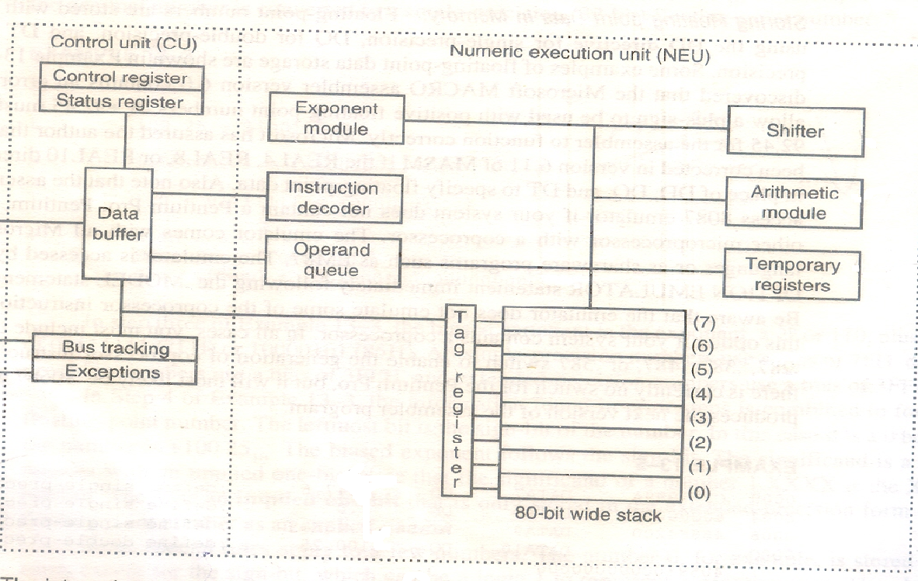
Internal Structure of the 8087
Data
Status
Address

Slide 12
This device is divided into 2 major sections: the control unit and the numeric execution unit
The control unit interfaces the coprocessor to the microprocessor system data bus
Both of the devices monitor the instruction stream
If the instruction is coprocessor instruction, the coprocessor executes it; if not, the microprocessor executes it

Slide 13
The Numeric Execution Unit (NEU) is responsible for executing all coprocessor instructions
The NEU has an eight-register stack that holds operands for arithmetic instructions and the results of arithmetic instructions
The instructions either address the data in specific stack data registers or use a push and pop mechanism to store and retrieve data on the top of the stack
Other registers in the NEU are status, control, tag and exception pointers

Slide 14
A few instructions transfer data between the coprocessor and the AX register in the microprocessor
The stack within the coprocessor contains eight registers that are each 80-bit wide
These stack registers always contain an 80-bit extended precision floating point number
The coprocessor converts from signed integer, BCD, single precision, or double precision form as the data are moved between the memory and the coprocessor register stack

Slide 15
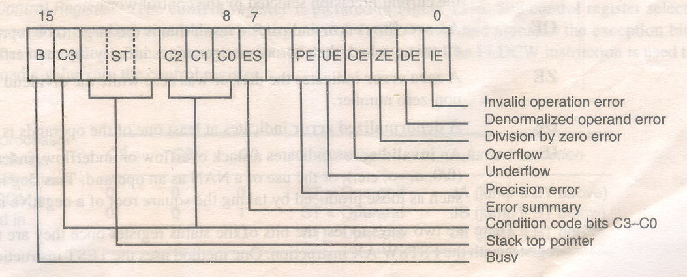
Status register

Slide 16
B : Busy bit indicates that the coprocessor is busy executing a task
C3 – C0 : The condition code bits indicate conditions about the coprocessor like unnormal, NAN etc
TOP: The top-of-stack (ST) bit indicates the current register addresses as the top-of-the-stack (ST). This is normally register 0
ES: the error summary bit is set if any unmasked error bit (PE, UE, OE, ZE, DE, or IE) is set

Slide 17
PE: the precision error indicates that the result or operands exceed selected precision
UE: An underflow error indicates a non-zero result that is too small to represent with the current precision selected by the control word
OE: An overflow indicates a result that is too large to be represented
ZE: A zero error indicates the divisor was zero while the dividend is a non-infinity or non-zero number

Slide 18
DE: A denormalized error indicates at least one of the operands is denormalized
IE: An invalid error indicates a stack overflow or underflow, indeterminate form (0/0, etc), or the use of a NAN as an operand. This flag indicates errors such as those produced by taking the square root of a negative number, etc

Slide 19
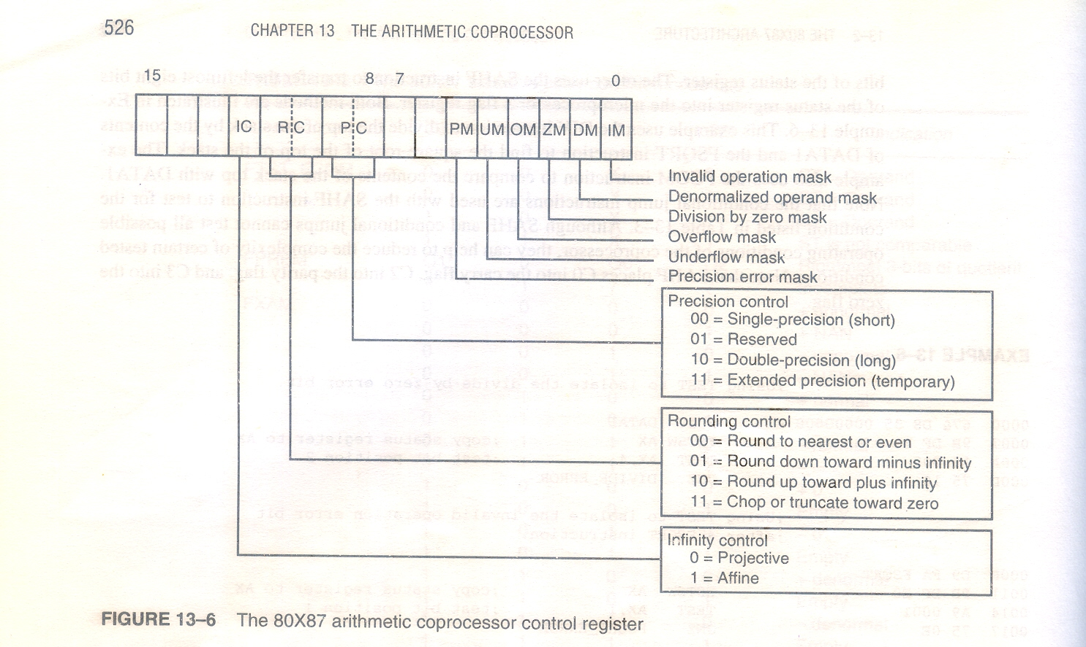
Control register

Slide 20
IC: Infinity Control selects either affine or projective infinity. Affine allows positive and negative infinity, while projective assumes infinity is unsigned
RC: Rounding Control determines the type of rounding
PC: The precision control sets the precision of the result
Exception masks: determine whether the error indicated by the exception affects the error bit in the status register. If a logic 1 is placed in one of the exception control bits, the corresponding status register is masked off

Slide 21
The FLDCW instruction is used to load a value into the control register

Slide 22
Tag register
The tag register indicates the contents of each location in the coprocessor stack
The tag indicates whether a register is valid, zero, invalid or infinity or empty

Slide 23
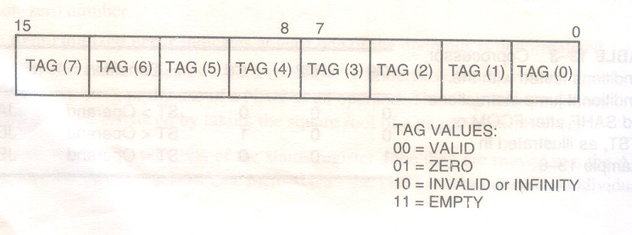

Slide 24
